Slide 1
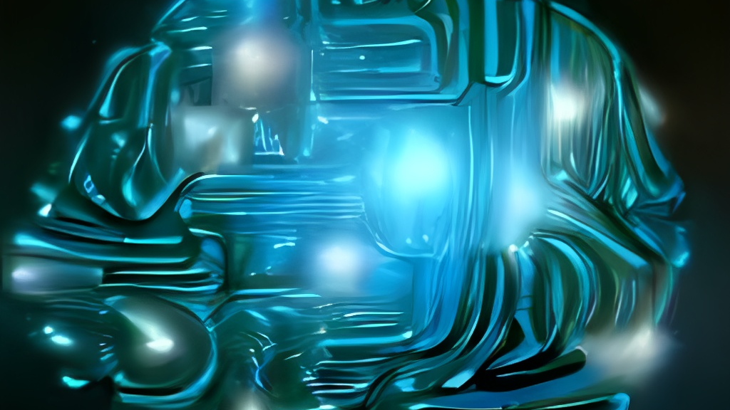
Alphabet Glossary A-Z: Exploring Terms and Definitions
Understanding key concepts in Technology and Computer Vision.
Aima Ayaz
24th September 2025
ITAI 2374
This Photo by Unknown Author is licensed under CC BY-SA

Slide 2
Outline of Topics
Exploring AI-Powered Computer Vision Applications
Advancements in Medical Imaging & Healthcare
AI-Driven Innovations in Autonomous Systems & Transportation
Security & Identity Verification Using AI Vision Technologies
Impact of AI on Image Recognition & Smart Surveillance

Slide 3

Artificial Intelligence Definition: AI refers to the ability of a computer or machine to perform tasks that typically require human intelligence, such as learning, reasoning, problem-solving, and decision-making

Slide 4

A: Affine Transformation
Meaning: An affine transformation is a geometric operation in computer vision that preserves parallelism and straight lines while allowing changes in scale, rotation, translation, and shear. It helps modify images while maintaining their essential structure.
Example: Face recognition systems use affine transformations to align facial features by adjusting the orientation and scale of detected faces
Notes:
This concept is widely used in image processing, object detection, and computer graphics.

Slide 5

B: Backpropagation
Meaning: Backpropagation is an optimization algorithm used in training neural networks. It works by adjusting the weights of the network based on the error between predicted and actual outputs, allowing the model to learn and improve over time.
Example: AI-powered handwriting recognition uses backpropagation to refine its ability to correctly identify letters by continuously adjusting its neural network weights.
Notes:
This technique is fundamental to deep learning and helps AI models become more accurate.

Slide 6

C: Cascade Classifier
Meaning: A cascade classifier is a machine learning technique used in object detection, where multiple classifiers are applied sequentially to improve accuracy. It is commonly used for detecting faces, eyes, and other objects in images.
Example: Face detection algorithms use cascade classifiers to identify human faces in real-time security systems by filtering out non-face regions step by step.
Notes:
This method is widely used in computer vision for efficient and fast object recognition.

Slide 7

D: Depth Estimation
Meaning: Depth estimation is a computer vision technique used to determine the distance of objects from a camera by analyzing a 2D image or video. It helps AI understand spatial relationships and create 3D representations from flat images.
Example: Self-driving cars use depth estimation to measure the distance between vehicles and obstacles, enabling safe navigation
This Photo by Unknown Author is licensed under CC BY-SA
Notes:
This method is widely applied in robotics, augmented reality, and medical imaging.

Slide 8
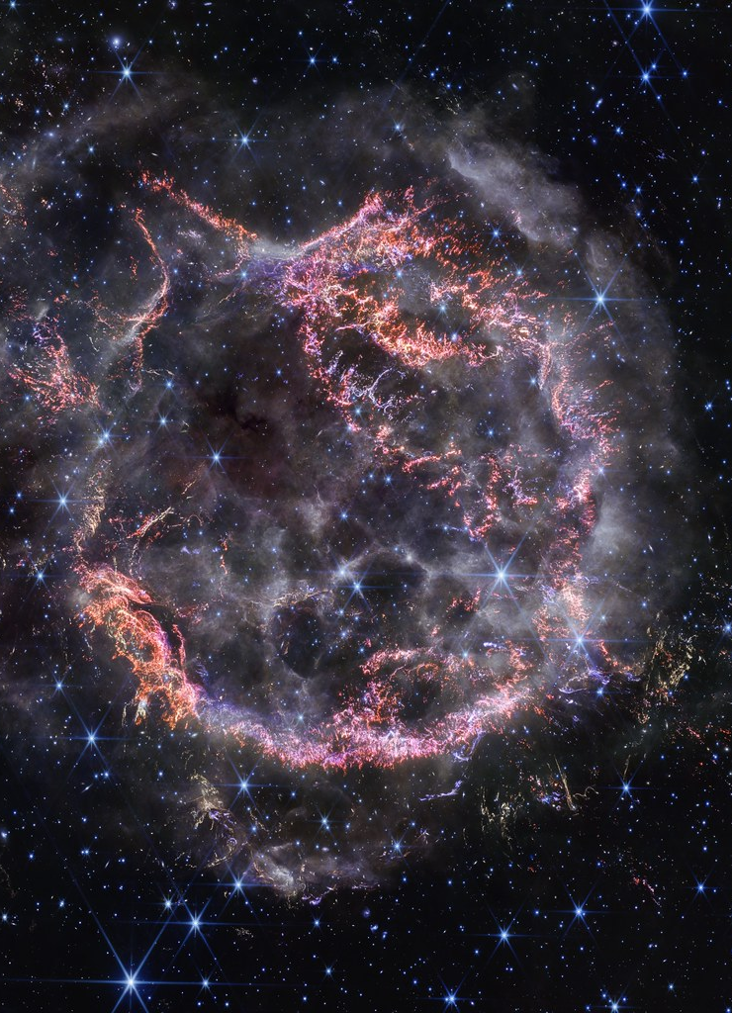
E: Edge Detection
Meaning: Edge detection is a fundamental technique in computer vision that identifies boundaries within an image by detecting sharp changes in brightness or color. It helps highlight important structures and features in an image.
Example: Self-driving cars use edge detection to recognize lane markings and road boundaries, improving navigation accuracy
This Photo by Unknown Author is licensed under CC BY
Notes:
This method is widely applied in image processing, object detection, and medical imaging.

Slide 9
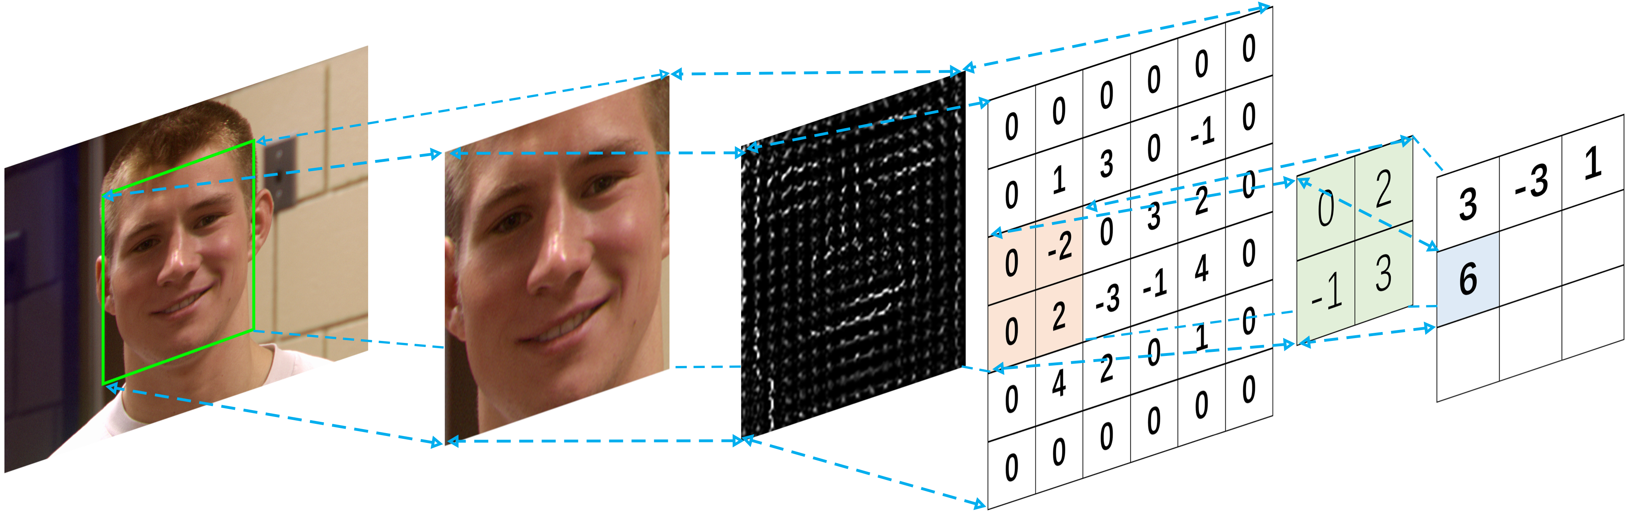
F: Feature Extraction
Meaning: Feature extraction is a process in computer vision where key characteristics of an image—such as edges, textures, or patterns—are identified and transformed into a format that AI models can analyze efficiently. It helps reduce complexity while preserving important details.
Example: Facial recognition systems use feature extraction to detect unique facial landmarks, enabling accurate identification
This Photo by Unknown Author is licensed under CC BY
Notes:
This technique is essential for image classification, object detection, and medical imaging.

Slide 10

G: Gradient Decent
Meaning: Gradient descent is an optimization algorithm used in machine learning and computer vision to minimize a loss function by iteratively adjusting model parameters. It helps AI models learn by reducing errors in predictions.
Example: Image classification models use gradient descent to refine their ability to recognize objects by continuously adjusting neural network weights
This Photo by Unknown Author is licensed under CC BY-SA
Notes:
This technique is fundamental to deep learning and helps AI models become more accurate.

Slide 11

H: HOG
Meaning: HOG is a feature descriptor used in computer vision for object detection. It works by analyzing the distribution of gradient orientations in an image, helping AI recognize shapes and patterns.
Example: Pedestrian detection systems use HOG to identify people in images by analyzing edge directions and textures
Notes:
This technique is widely applied in image recognition, object detection, and machine learning.

Slide 12

I: Invisible Computing
Meaning: Invisible computing refers to technology that seamlessly integrates into everyday environments, operating in the background without requiring direct user interaction. It enhances convenience by making computing ubiquitous and unobtrusive.
Example: Smart homes use invisible computing to automatically adjust lighting, temperature, and security settings based on user preferences—without needing manual input
This Photo by Unknown Author is licensed under CC BY
Notes:
This concept is shaping the future of AI-driven automation, smart environments, and wearable technology.

Slide 13
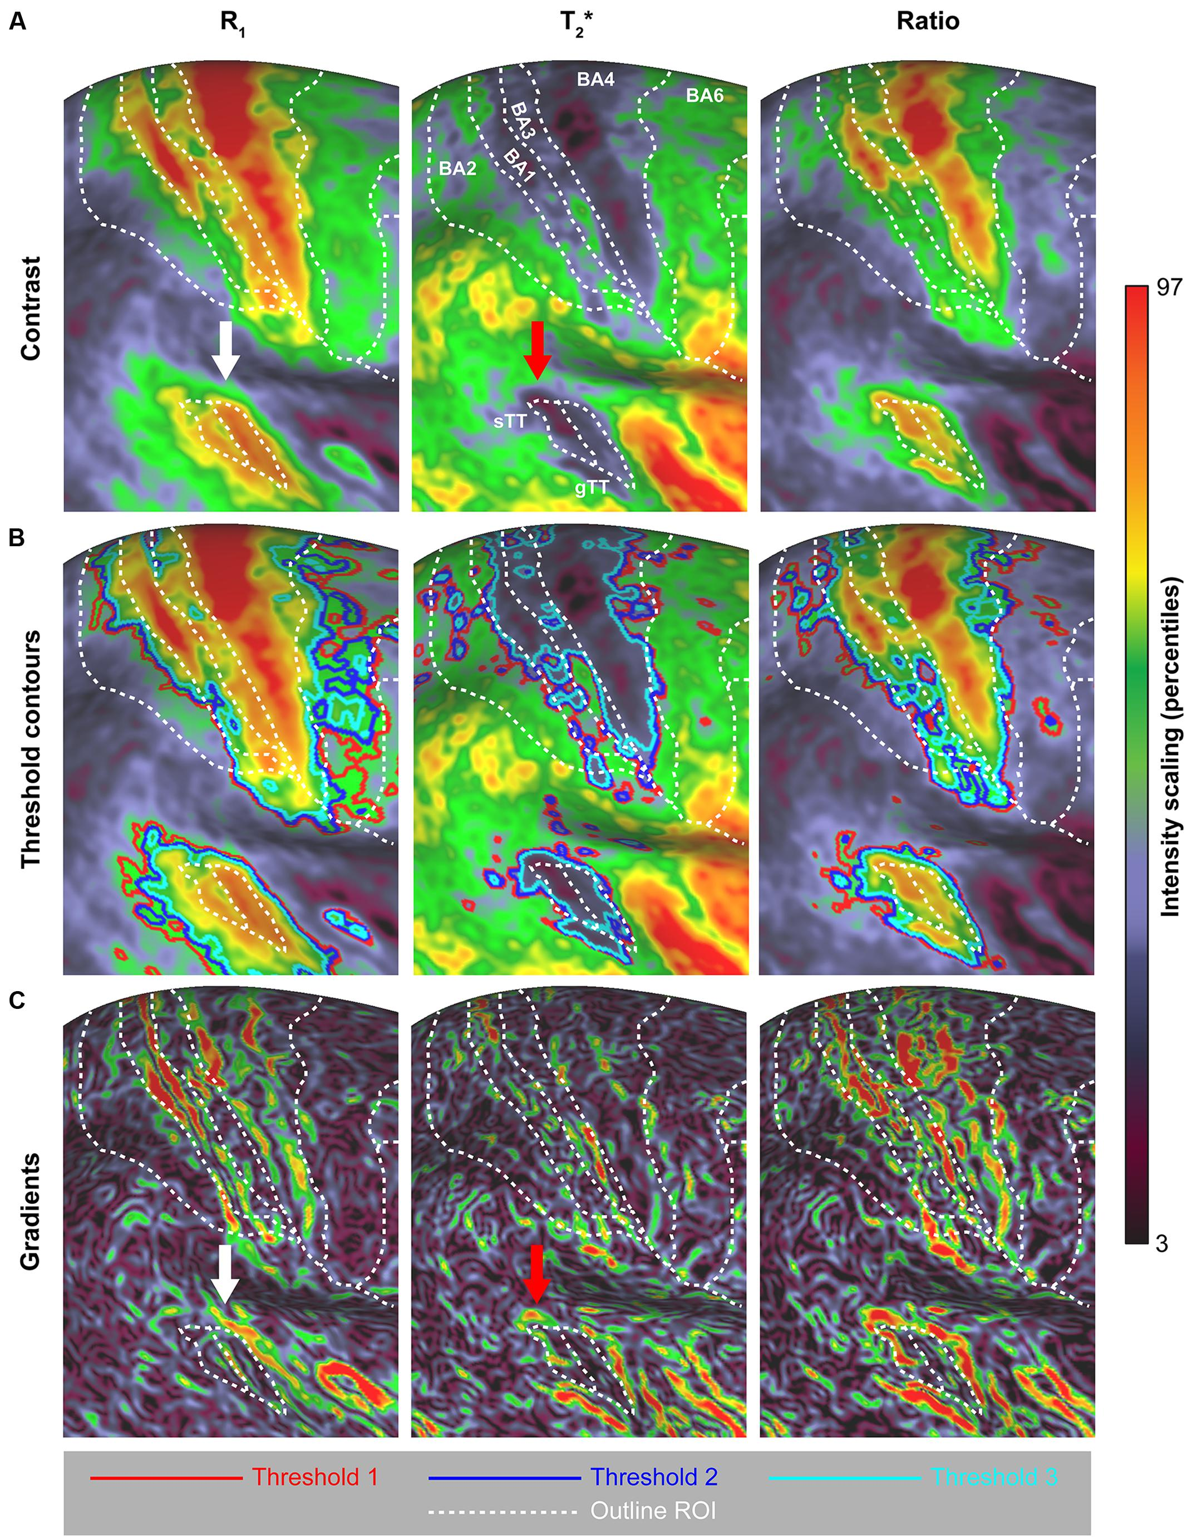
J: Jaccard Index
Meaning: The Jaccard Index is a similarity measure used in computer vision and machine learning to compare the overlap between two sets. It is calculated as the ratio of the intersection size to the union size of the sets.
Example: Object detection algorithms use the Jaccard Index (also called Intersection over Union, IoU) to evaluate how accurately predicted bounding boxes match ground truth annotations
This Photo by Unknown Author is licensed under CC BY
Notes:
This metric is widely applied in image segmentation, clustering, and text analysis.

Slide 14

K: Keypoint Detection
Meaning: Keypoint detection is a computer vision technique that identifies specific, distinct points within an image, often used to recognize objects, track movements, or analyze patterns. These keypoints serve as reference markers, helping AI understand spatial relationships in visual data.
Example: Human pose estimation uses keypoint detection to track body movements by identifying key points like joints, elbows, and knees, enabling applications in fitness tracking and augmented reality
Notes:
This method is widely applied in facial recognition, object tracking, and medical imaging.

Slide 15
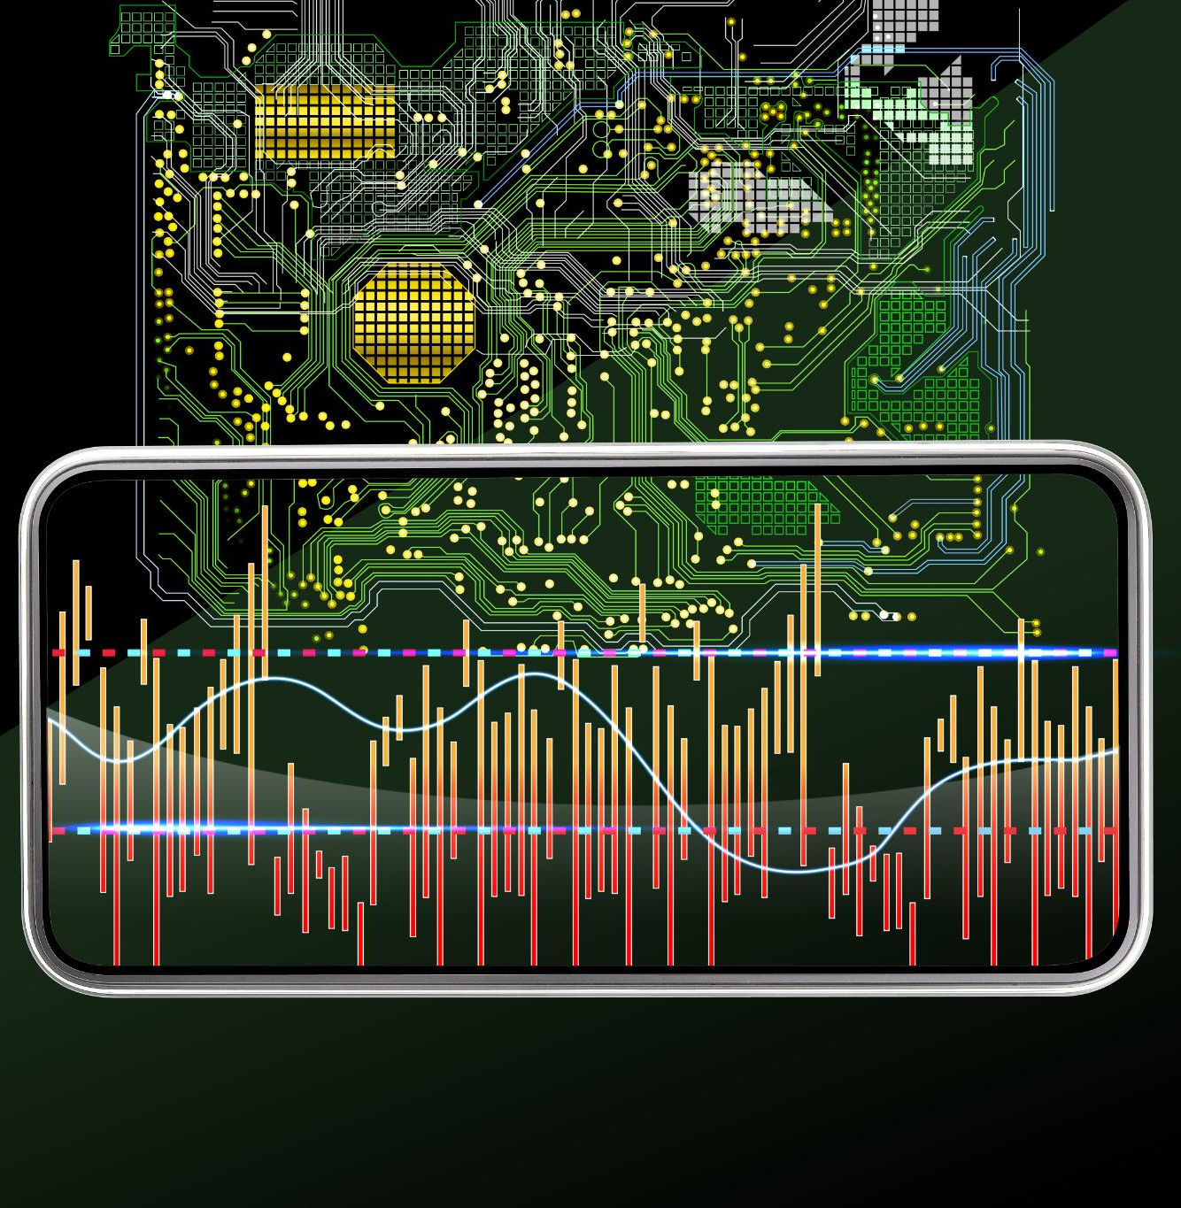
L: LiDAR (Light Detection and Ranging)
Meaning: LiDAR is a remote sensing technology that uses laser pulses to measure distances and create detailed 3D maps of environments. It helps AI understand depth and spatial relationships in computer vision applications.
Example: Self-driving cars use LiDAR to detect obstacles, measure distances, and navigate safely by generating real-time 3D maps of their surroundings.
Notes:
LiDAR is widely used in autonomous vehicles, robotics, environmental mapping, and augmented reality.

Slide 16
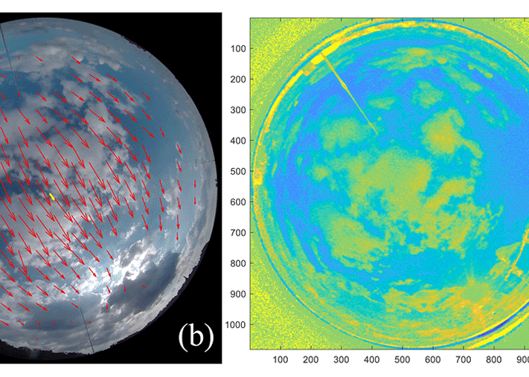
M: Motion Estimation
Meaning: Motion estimation is a computer vision technique used to track and predict the movement of objects across frames in a video. It helps AI understand how objects move in a scene, enabling applications like video compression, object tracking, and augmented reality.
Example: Self-driving cars use motion estimation to analyze the movement of pedestrians and vehicles, allowing for real-time decision-making and collision avoidance
This Photo by Unknown Author is licensed under CC BY
Notes:
This method is widely applied in video processing, robotics, and surveillance systems.

Slide 17

N: NAS
Meaning: NAS is an automated process that optimizes deep learning model structures by searching for the best-performing architecture without manual tuning. It helps AI models become more efficient and accurate in computer vision tasks.
Example: AI researchers use NAS to design neural networks for image classification and object detection, improving performance while reducing computational costs
Notes:
Neural Architecture Search is widely applied in computer vision, deep learning, and AI model optimization.

Slide 18
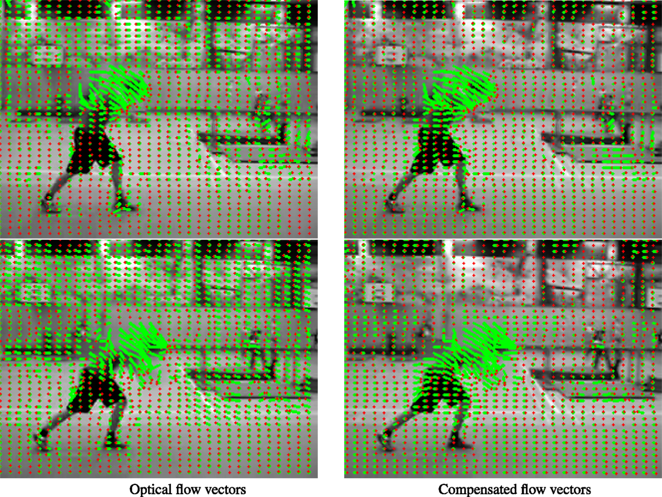
O: Optical Flow
Meaning: Optical flow is a computer vision technique that estimates the motion of objects between consecutive frames in a video. It analyzes pixel movement to understand scene dynamics and track motion patterns.
Example: Self-driving cars use optical flow to detect moving vehicles and pedestrians, helping them make real-time driving decisions.
Notes:
This method is widely applied in video processing, robotics, and augmented reality.

Slide 19

P: Pose Estimation
Meaning: Pose estimation is a computer vision technique that detects and tracks the position and orientation of objects or human body parts in images or videos. It helps AI understand spatial relationships and movement patterns.
Example: AI-powered fitness apps use pose estimation to analyze body posture and provide real-time feedback on exercise form
Notes:
This method is widely applied in augmented reality, robotics, and motion tracking.

Slide 20

Q: Quantization in Neural Network
Meaning: Quantization is a technique used in neural networks to reduce the precision of numerical values, such as weights and activations, from high-precision floating-point numbers (e.g., 32-bit) to lower-precision formats (e.g., 8-bit integers). This helps decrease memory usage and computational costs while maintaining model performance.
Example: AI models deployed on smartphones use quantization to run efficiently on limited hardware, allowing real-time image recognition without excessive power consumption
Notes:
This method is widely applied in edge computing, mobile AI, and embedded systems.

Slide 21
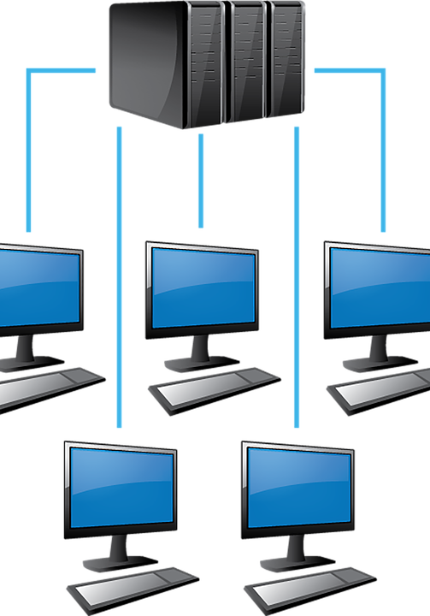
R: ResNet
Meaning: ResNet is a deep learning architecture designed to overcome the vanishing gradient problem in very deep neural networks. It introduces skip connections (or shortcut connections) that allow information to bypass multiple layers, making training more efficient and improving accuracy.
Example: Image recognition models use ResNet to classify objects in photos with high precision, enabling applications like medical imaging, autonomous driving, and facial recognition
Notes:
ResNet has revolutionized computer vision by enabling deeper networks without performance degradation.

Slide 22
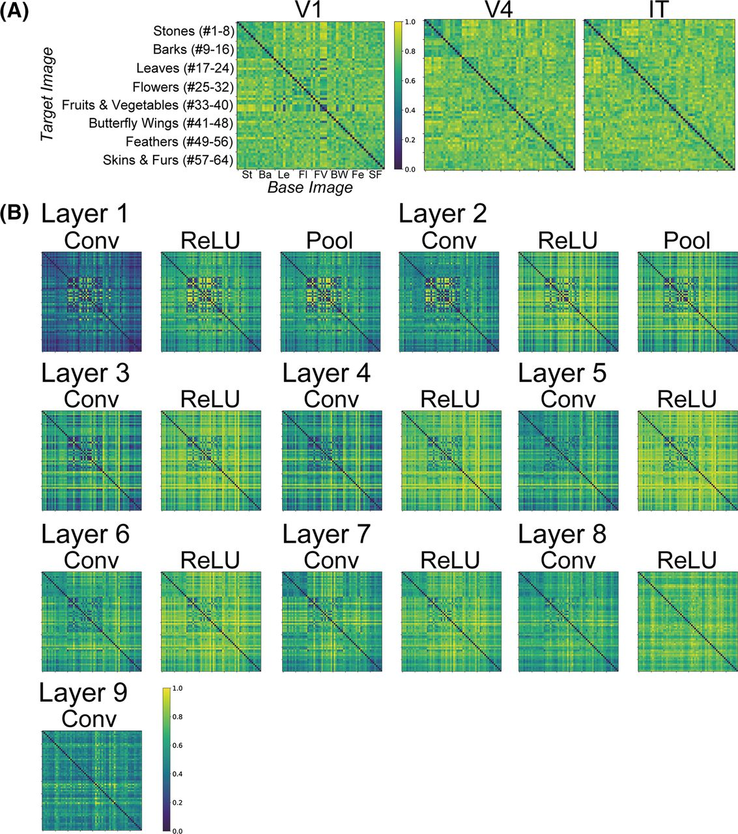
S: Saliency Mapping
Meaning: Saliency mapping is a computer vision technique that highlights the most important or attention-grabbing regions in an image. It helps AI models understand which parts of an image are most relevant for tasks like object detection, image segmentation, and explainable AI.
Example: Autonomous vehicles use saliency mapping to focus on pedestrians and road signs, ensuring safe navigation by prioritizing critical visual information
This Photo by Unknown Author is licensed under CC BY
Notes:
This method is widely applied in image processing, deep learning, and human-computer interaction.

Slide 23

T: Transposed Convolution
Meaning: Transposed convolution, also known as fractionally-strided convolution, is a technique used in deep learning to upsample feature maps by reversing the effects of standard convolution. Instead of reducing spatial dimensions, it expands them, making it useful for tasks like image reconstruction and segmentation.
Example: Semantic segmentation models use transposed convolution to restore fine details in images, ensuring pixel-level classification for applications like medical imaging and autonomous driving
This Photo by Unknown Author is licensed under CC BY
Notes:
This method is widely applied in computer vision, generative models, and deep learning architectures.

Slide 24
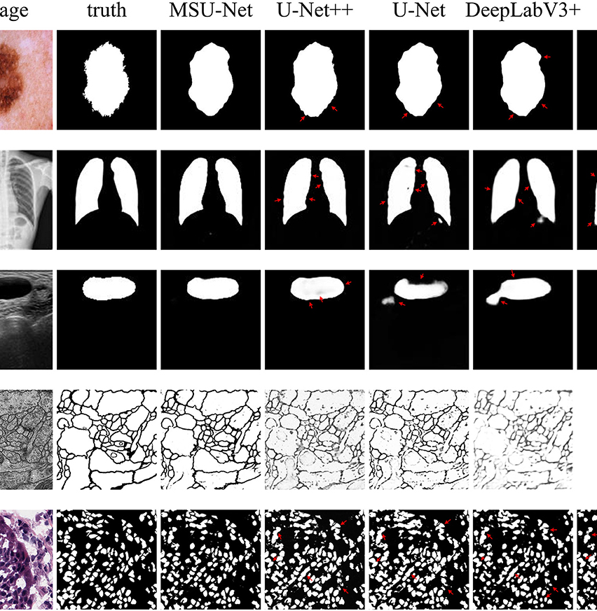
U: U-Net
Meaning: U-Net is a deep learning architecture designed for image segmentation, particularly in medical imaging. It follows an encoder-decoder structure with skip connections, allowing precise pixel-level classification.
Example: Medical imaging systems use U-Net to segment organs and tumors in MRI scans, aiding in disease diagnosis and treatment planning
This Photo by Unknown Author is licensed under CC BY
Notes:
U-Net is widely applied in autonomous driving, satellite imagery, and biomedical research.

Slide 25

V: VAE
Meaning: A VAE is a type of generative model that learns to represent data in a lower-dimensional latent space. It combines autoencoders with variational inference, allowing it to generate new data points similar to the training data.
Example: Image generation models use VAE to create realistic images by learning patterns from existing datasets, often used in art generation, anomaly detection, and data reconstruction
Notes:
Variational Autoencoder is widely applied in computer vision, deep learning, and AI-driven creativity.

Slide 26

W: Warping
Meaning: Warping is a computer vision technique used to distort or transform an image while preserving its essential structure. It allows for corrections, modifications, or creative alterations in images and videos.
Example: Face recognition systems use warping to align facial features by adjusting the orientation and scale of detected faces, ensuring accurate identification
Notes:
Warping is widely applied in image processing, augmented reality, and video editing.

Slide 27
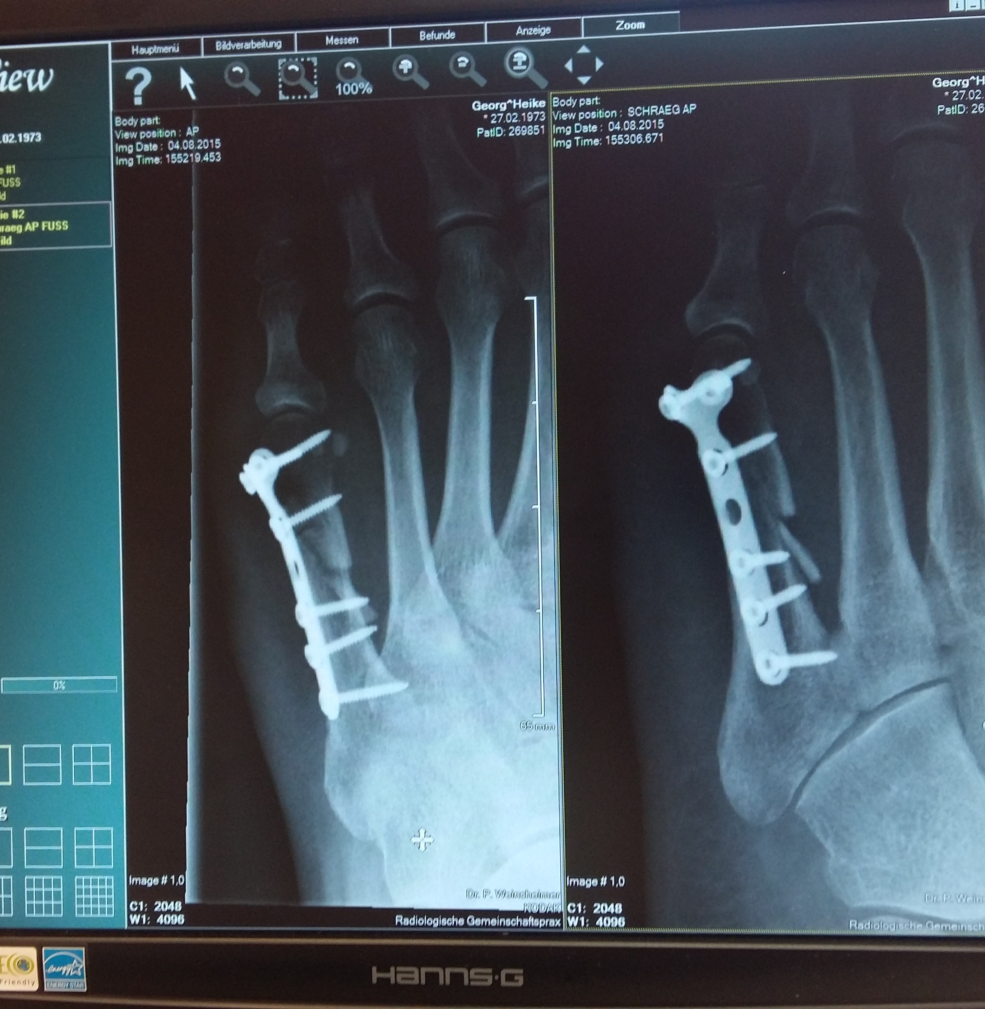
X: X-Ray Image Enhancement
Meaning: X-ray image enhancement is a computer vision technique used to improve the clarity, contrast, and visibility of details in X-ray images. It helps highlight important features, making medical diagnoses and industrial inspections more accurate.
Example: Medical imaging systems use contrast enhancement and noise reduction to improve the visibility of fractures and abnormalities in X-ray scans, aiding radiologists in diagnosis
Notes:
This method is widely applied in healthcare, security screening, and industrial defect detection.

Slide 28

Y: YOLO
Meaning: YOLO is a real-time object detection algorithm that processes an entire image in a single pass, making it extremely fast and efficient. It treats object detection as a regression problem, predicting bounding boxes and class probabilities simultaneously.
Example: Self-driving cars use YOLO to detect pedestrians, vehicles, and obstacles in real time, enabling quick decision-making for safe navigation.
Notes:
YOLO is widely applied in computer vision, surveillance, and autonomous systems.

Slide 29

Z: Zero Padding
Meaning: Zero padding is a technique used in convolutional neural networks (CNNs) to add extra pixels (with a value of zero) around the edges of an image before applying convolution operations. This helps preserve spatial dimensions and improve feature extraction.
Example: Image classification models use zero padding to maintain the size of input images, ensuring that important edge features are not lost during convolution
Notes:
This method is widely applied in computer vision, deep learning, and AI-based image processing.

Slide 30
Conclusion
Importance of Glossary
The glossary serves as a fundamental tool for understanding key technology concepts and definitions.
Navigating Technology
Familiarity with these terms is essential for effectively navigating the complexities of today's digital landscape.
A to Z Coverage
The presentation has provided a comprehensive overview, covering essential terms from A to Z in technology.

